Slide 1
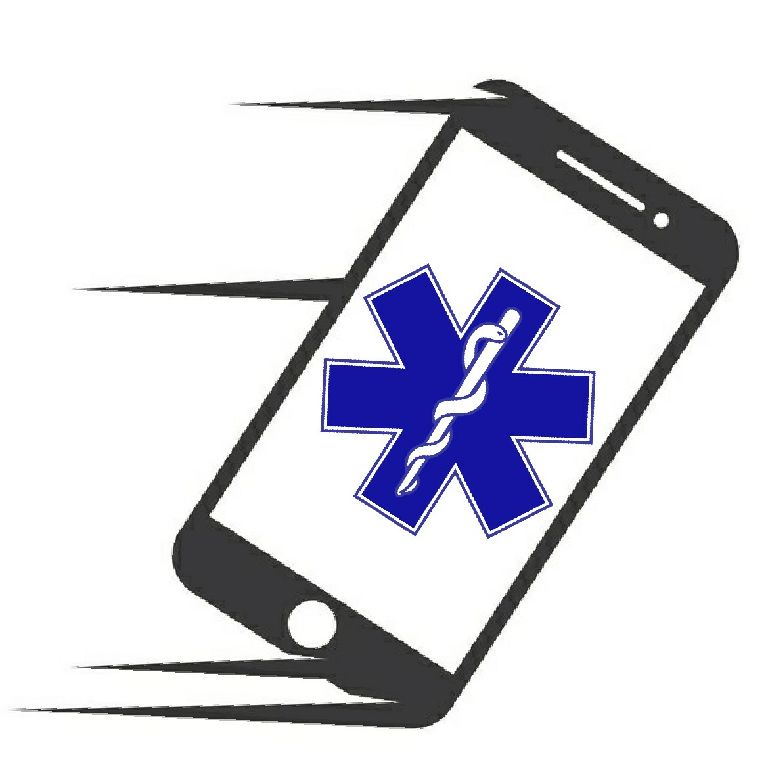
The Problem
Medic Manual
EMTeam: Molly Clare, Vincent Futrell, Sierra Johnson and Andrew Stender
School of Computing Capstone 2021, University of Utah

Slide 2
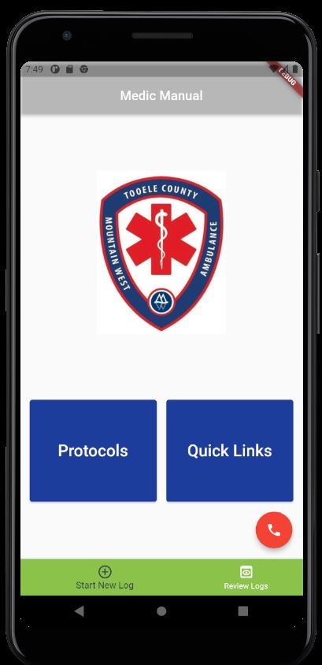
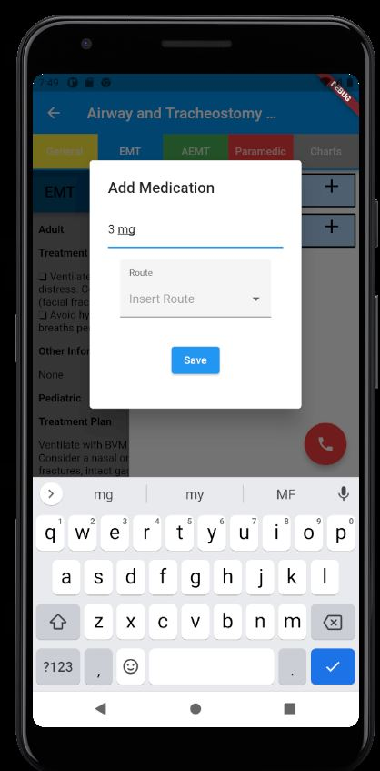
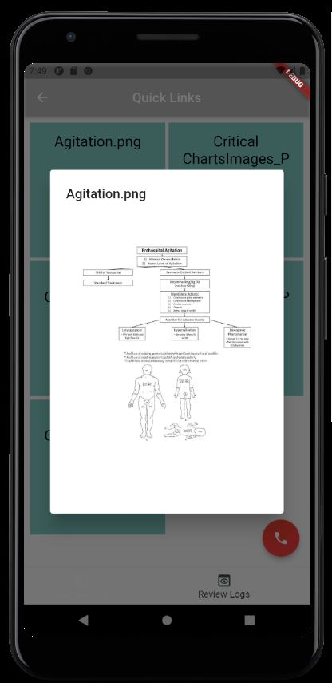
Mobile Application
Medic Manual
EMTeam: Molly Clare, Vincent Futrell, Sierra Johnson and Andrew Stender
School of Computing Capstone 2021, University of Utah
Cross Platform - Android and iOS
Mountain West Ambulance Protocols in one place
Searchable protocols
Protocols categorized as General, EMT, AEMT, and Paramedic
Charts are visible per Protocol, as well as optionally in Quick Links
Full zoomability
Supports logging of medications
Review, edit, and delete logs
OLMC button
Make calls to pre-entered Hospitals to approve administering care.

Slide 3
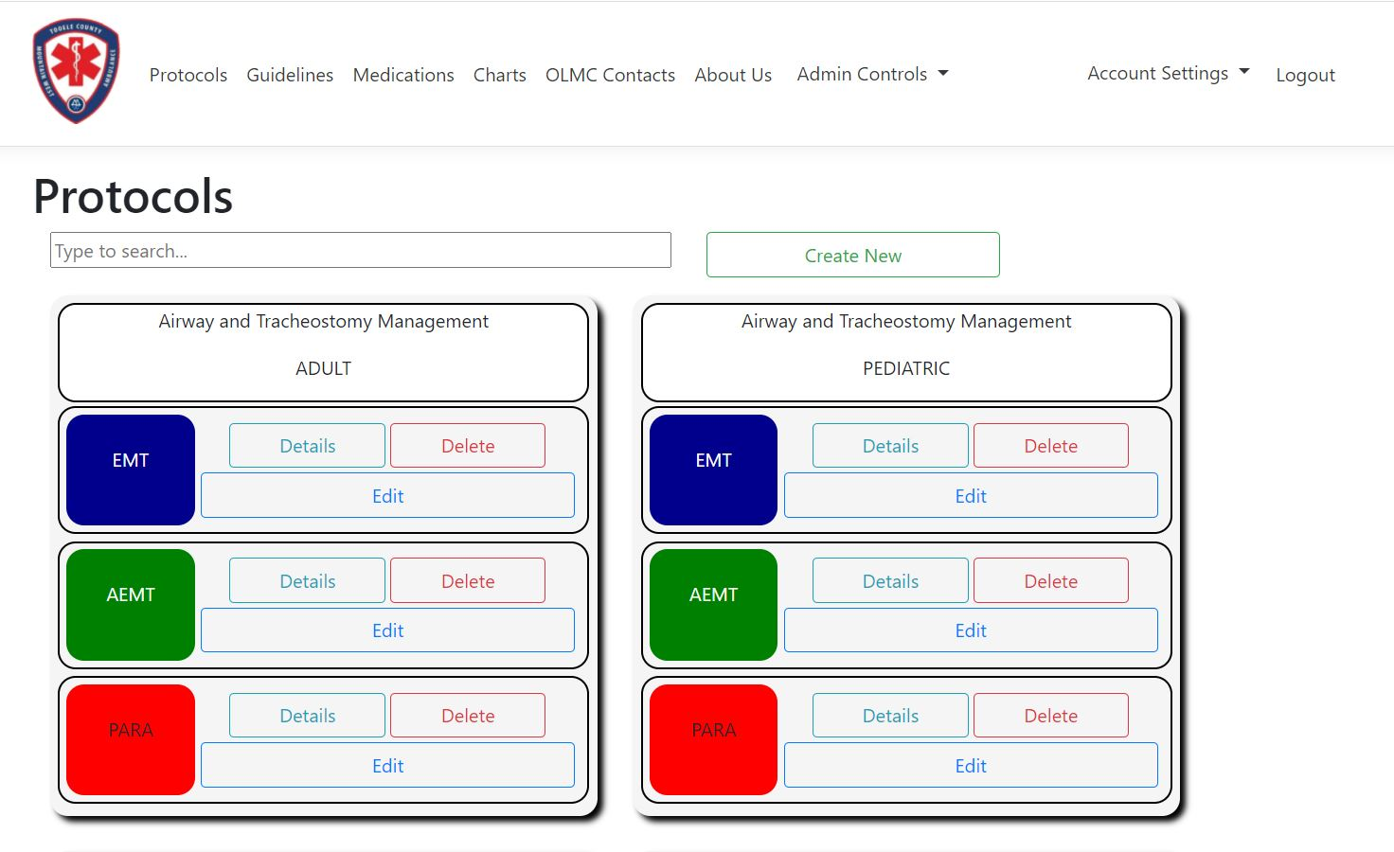
Web Portal https://mwaprotocol.com
Medic Manual
EMTeam: Molly Clare, Vincent Futrell, Sierra Johnson and Andrew Stender
School of Computing Capstone 2021, University of Utah
Administrators enter the handbook via the web portal, which is then retrieved by the app upon reloading.
Enter Protocols, Guidelines, Medications, Charts, and OLMC contacts
Associate medications with protocols so they can be logged in the app
Edit, read, and delete if needed
Administrator role:
Create other accounts with their email
Delete, and change the roles of other accounts
Director role:
Create and edit handbook information
All users can reset their password
Search through protocols easily

Slide 4
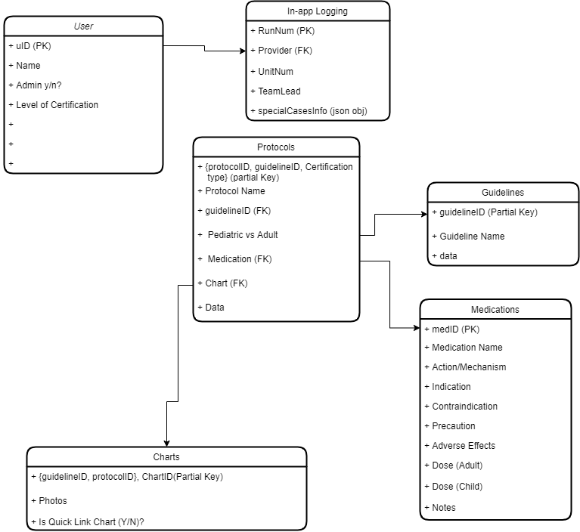
Technologies
Medic Manual
EMTeam: Molly Clare, Vincent Futrell, Sierra Johnson and Andrew Stender
School of Computing Capstone 2021, University of Utah
Mobile App
Flutter (Dart)
SQLflite
VS Code
Android Studio for emulator
Web Portal
ASP.NET Core
MySQL
JavaScript
HTML/CSS
C#
AWS microservices for .NET
Visual Studio
Database Schema

